Slide 1
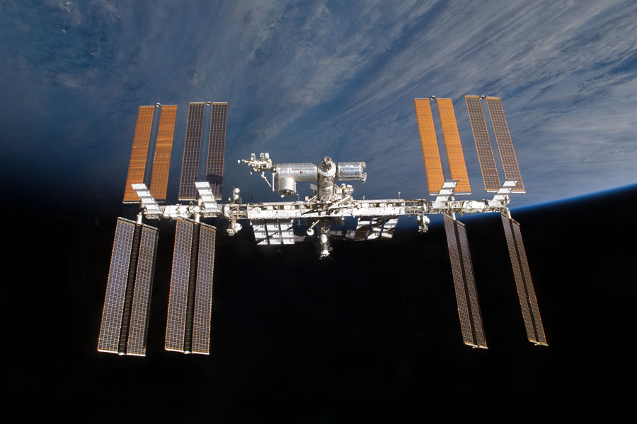
Multiphase Flow Research on the International Space Station
Brian J. Motil and John B. McQuillen
NASA Glenn Research Center, Cleveland, OH
1

Slide 2
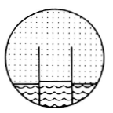
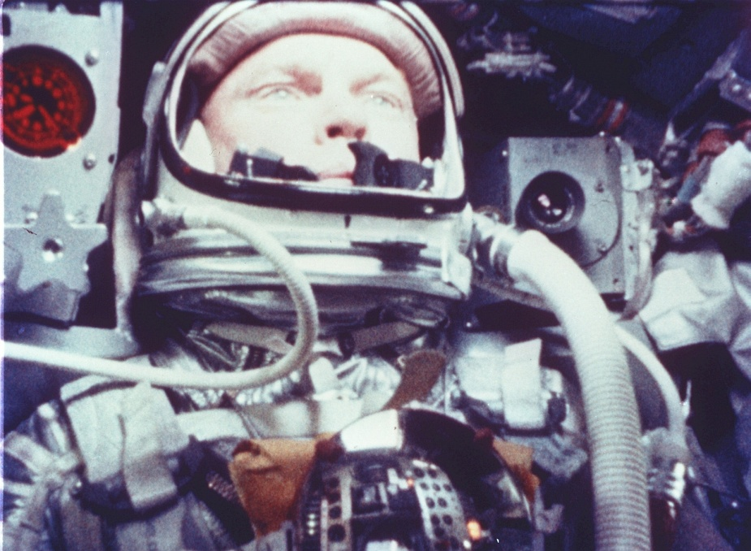
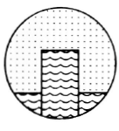
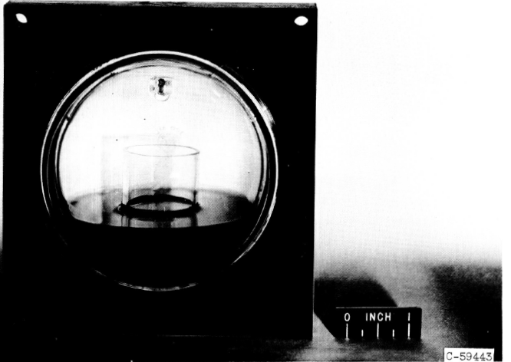
LeRC Developed the First Microgravity Fluid Physics Flight Experiment, on Mercury–Atlas–7 (MA-07) May 24, 1962
MA-07 commander, Scott Carpenter
Cylindrical baffle in a spherical tank geometry
Experiment H/W Tank: 3.3 in. dia (glass)
Baffle: 1.1 in. dia, 1.9 in. length
Test fluid: distilled water w/ dye, ethyl alcohol
(a)
(b)
Fluid configuration in spherical tank
a) during a retrofire
b) equilibrium condition in zero g.
Lewis Research Center’s Experiment Principal Investigators:
D. Petrash, R. Nussle, and E. Otto

Slide 3
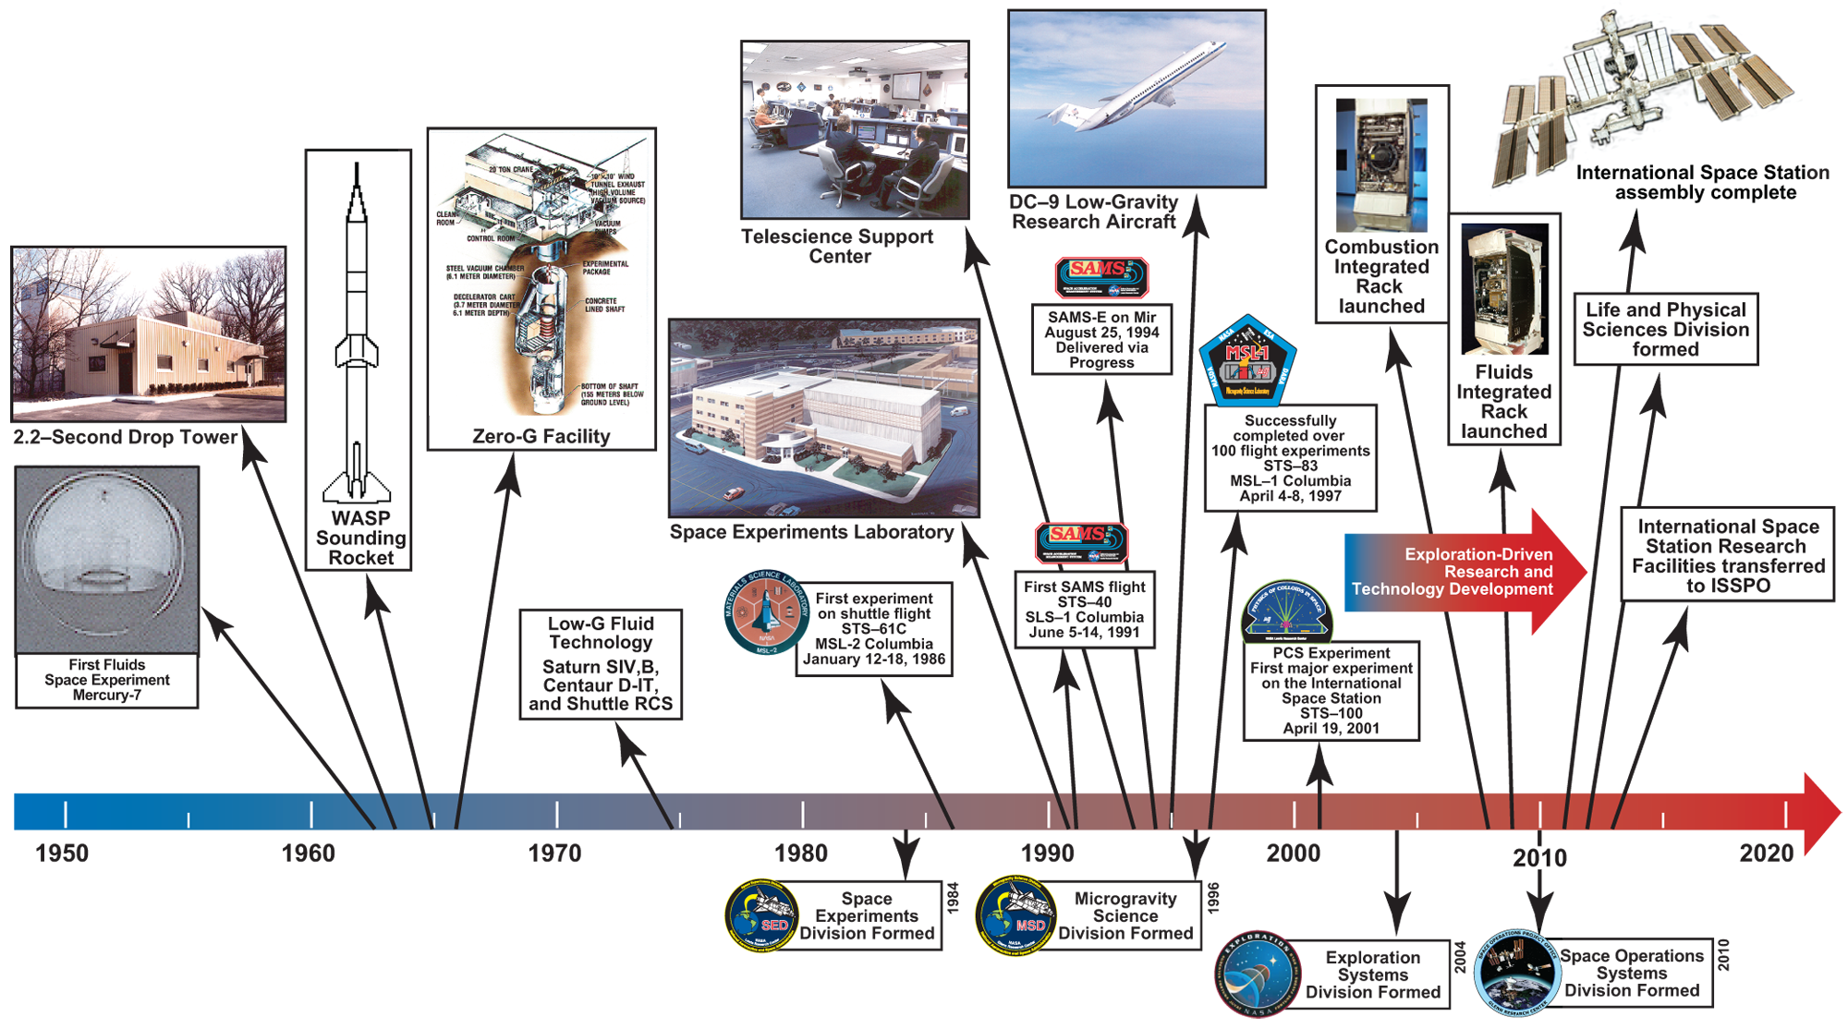
Glenn Research Center’s Role in Gravity-Dependent Research in Space

Slide 4


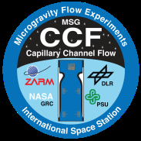



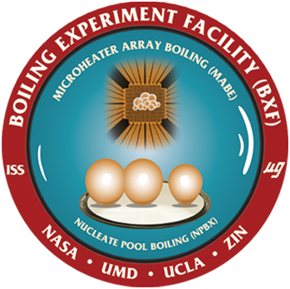



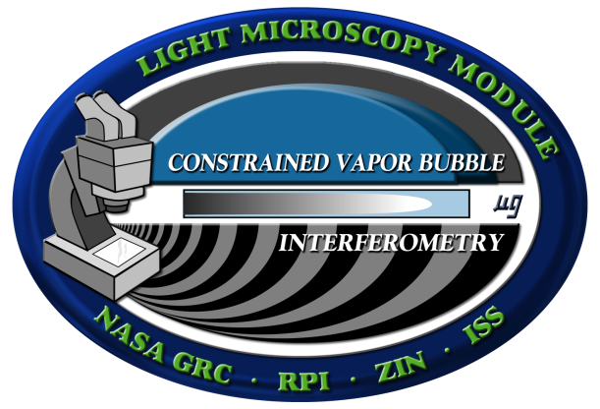

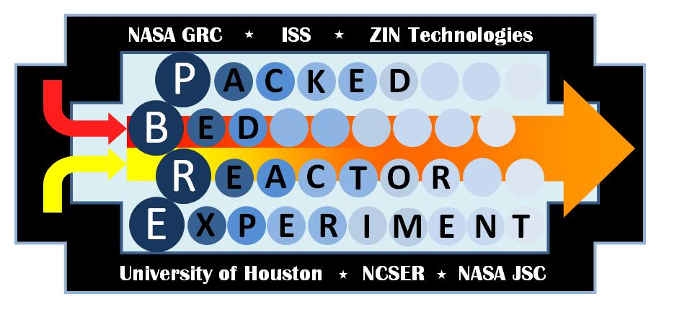
Fluid Physics and Complex Fluids Today
Fluid Physics
Complex Fluids
Two-phase flow
Phase separation
Boiling, condensation
Capillary and
interfacial phenomena
Colloids
Liquid crystals
Foams
Granular flows
Notes:
Along with a sister Combustion group we have flown over 150 total space experiments on the shuttle, MIR, sounding rockets
Over 50 experiments to date on the ISS

Slide 5
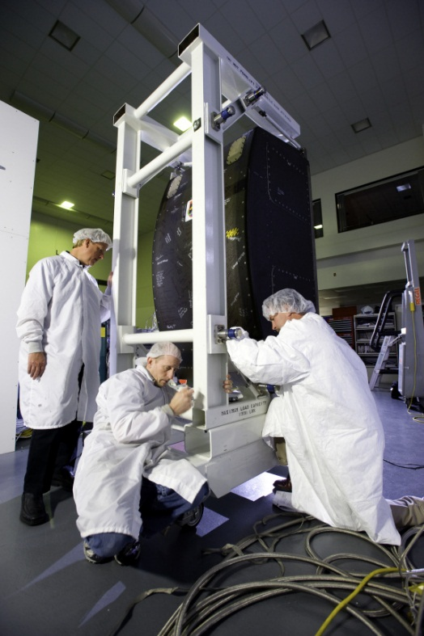
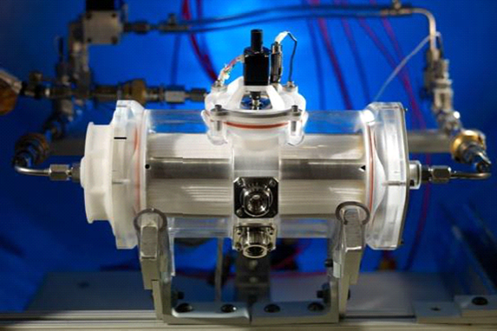
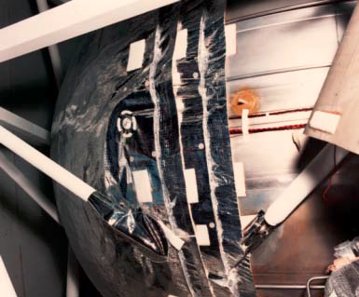
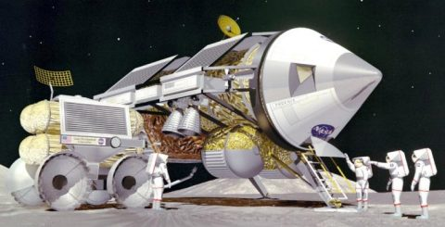
Guiding ISS Research
The overarching goal in fluids is to develop a sufficient database for future spacecraft designers such that they can select the optimum fluid system in the relevant environment (partial or 0-g).
Database will establish the basis (closure laws) for CFD models.
Models/design guidelines then become the basis for technology development.
External teams (FluidsLAB) were formed in 2014 to focus on near-term/ISS research, giving special consideration (when possible) to using existing hardware with minor modifications.
“Calculations of gas-liquid flows on earth are not done using “exact” equations but rely rather heavily on empirical models. Hence, prediction of behavior in space is not a matter of turning off the gravity term in the calculations.”
ECLSS Water Recovery Rack
Spacesuit Water Membrane Evaporator (SWME)
Cryogen Tank
Notes:
We do fundamental work to address technology needs – buy down risks for Space Exploration.
Closure Laws: approximations such as Reynolds stress tensor, phase boundary locations, etc.

Slide 6
FluidsLAB Priorities
Multiphase Systems
Without heat transfer
With heat transfer
Adiabatic Two-Phase Flows
Boiling and Condensation
#1: Flow Regimes
#2: Instability Phenomena
#3: Bubble and Droplet Dynamics
#1: Flow Boiling – Critical Heat Flux and Flow Instabilities.
#2: Flow Condensation in Channels.
#3: Microgravity Issues Relevant to Two Phase Systems
Capillary Flow and Interfacial Phen.
Cryogenic Storage and Handling
#1: Multi-User, Multi-Geometry Capillary Science and Technology Facility
#2: Imperfect Wetting Phenomena – Science and Applications
#3: Global Equilibrium in Non-Symmetric/Symmetric Geometries for Liquid Management
#1: Large scale cryogen storage tank demo.
#2: Active Tank Pressure control & Noncondensable Effects.
#3: Boiling, Turbulence, Impulse Accelerations,
Tank Chilldown & Pressurant Injection
#4: Phase Management & Control
Separate reports (4) published in International Journal of Transport Phenomena - IJTP Volume 14, Number 2 (2015)

Slide 7
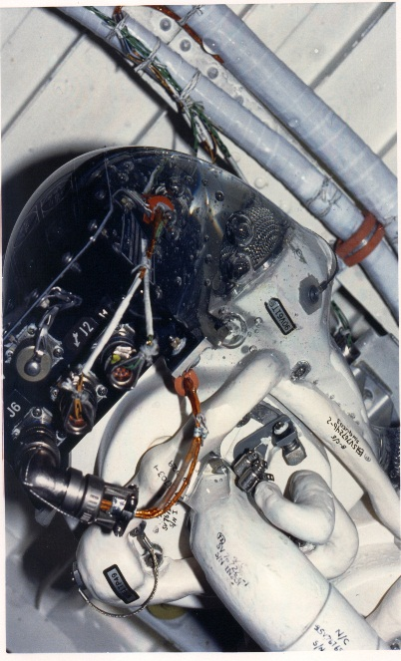
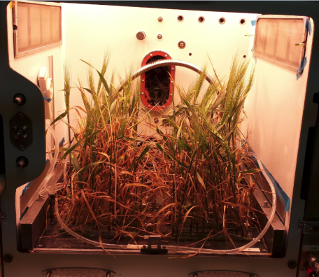
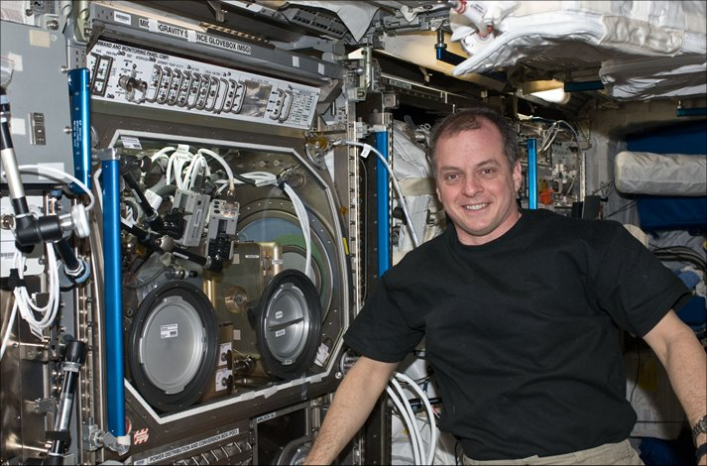
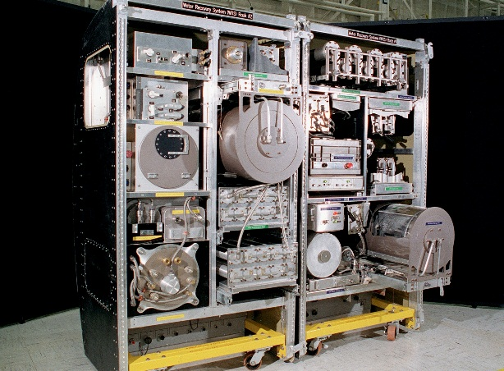
Adiabatic Two-Phase Flow - Applications
2011 Decadal: “… multiphase systems and thermal transport processes are enabling for proposed human exploration by NASA.”
Large Water Drop
Temperature and Humidity Control for Advanced Plant Habitat
Astronaut T. J. Creamer in front of IVGEN experiment: In-Situ generation of IV-grade fluid
Clogged Rotary Separator on STS 32
Prototype For Heat Melt Compactor Which Squeezes Trash And Recovers Water
Extravehicular Mobility Unit (EMU) With Water in Helmet During Post-EVA
23 Screening Test
ISS Water Recovery System
Notes:
Key is develop life support systems that are nearly “closed loop” to minimize mass required – critical to going beyond LEO for longer durations.

Slide 8
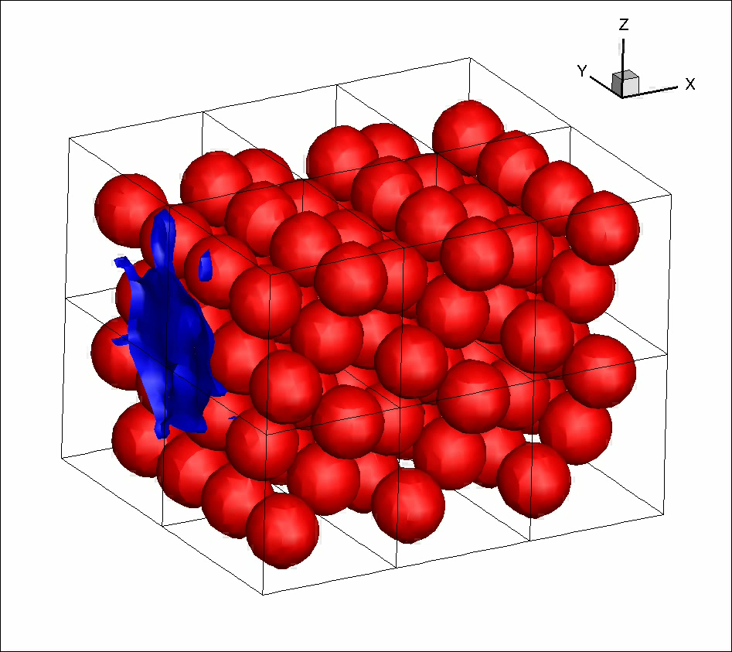
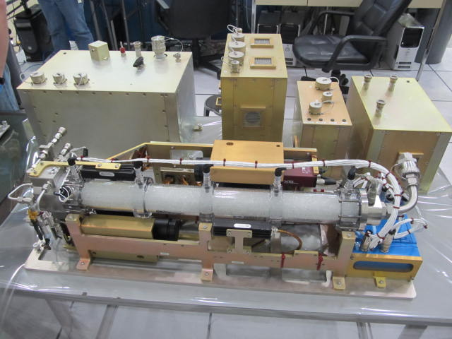
Adiabatic Two Phase Flow
PI: Dr. Brian Motil, NASA GRC
Co-I: Prof. Vemuri Balakotaiah, U. of Houston
Packed Bed Reactor Experiment (PBRE) - 2016 (on-going)
Investigating the role and effects of gravity on gas-liquid flow through porous media which is a critical component in life-support; thermal control devices; and fuel cells.
Validate and improve design and operational guidelines for gas-liquid reactors in partial and microgravity conditions.
Preliminary models predict significantly improved reaction rates in 0-g.
Models developed from early 0-g aircraft tests led to the successful operation of IntraVenous fluid GENeration (IVGEN) in 2010 providing the ability to generate IV fluid from in situ resources on the ISS.
Provides test fixture to test future two-phase flow components.
Pulse Flow CFD Model (Dr. Y. Lian)
PBRE Flight Hardware
Notes:
> PBRE is a small air/water two-phase flow facility – just completed first test section of operations on ISS in June.
Yongsheng Lian Model (video)
Qussai Mar-ash-deh (Tech 4 imaging).

Slide 9
Adiabatic Two Phase Flow
US Co-I: Prof. Alexander Yarin, University of Chicago
ESA PI: Prof. Cameron Tropea, Institute of Fluid Mechanics and Aerodynamics (SLA) Technische Universität Darmstadt
Dynamics of Liquid Film/ Complex Wall Interaction
(DOLFIN II) - 2019
ESA led experiment to develop continuum models to describe interactions between spreading fluids and chemically and/or morphologically complex surfaces in 0-g.
Ability to manipulate surface flows in microgravity is a key to thermal management solutions in space exploration.
US PI (Yarin) will perform experiments on spray cooling over specially patterned surfaces.
Recently developed numerical model to detail physical mechanisms of pool-boiling.
Boiling curves measured on nano-textured surfaces revealed heat fluxes 2-7 times higher than those on the bare surfaces, also increasing the CHF.
Polymer nanofiber mats significantly increase heat transfer in pool boiling in channel flows (this part was conducted together with the group of the Technical University of Darmstadt, Germany).
Nanofibers (a) are plated with copper (b) to form a mat that greatly alters nucleation patterns leading to much higher heat flux (d)
Notes:
Boiling curves measured on nano-textured surfaces revealed heat fluxes 2-7 times higher than those on the bare surfaces with the same surface superheat within the range of the heat flux supplied in the present work.
An increase of the critical heat flux (CHF) was found.

Slide 10
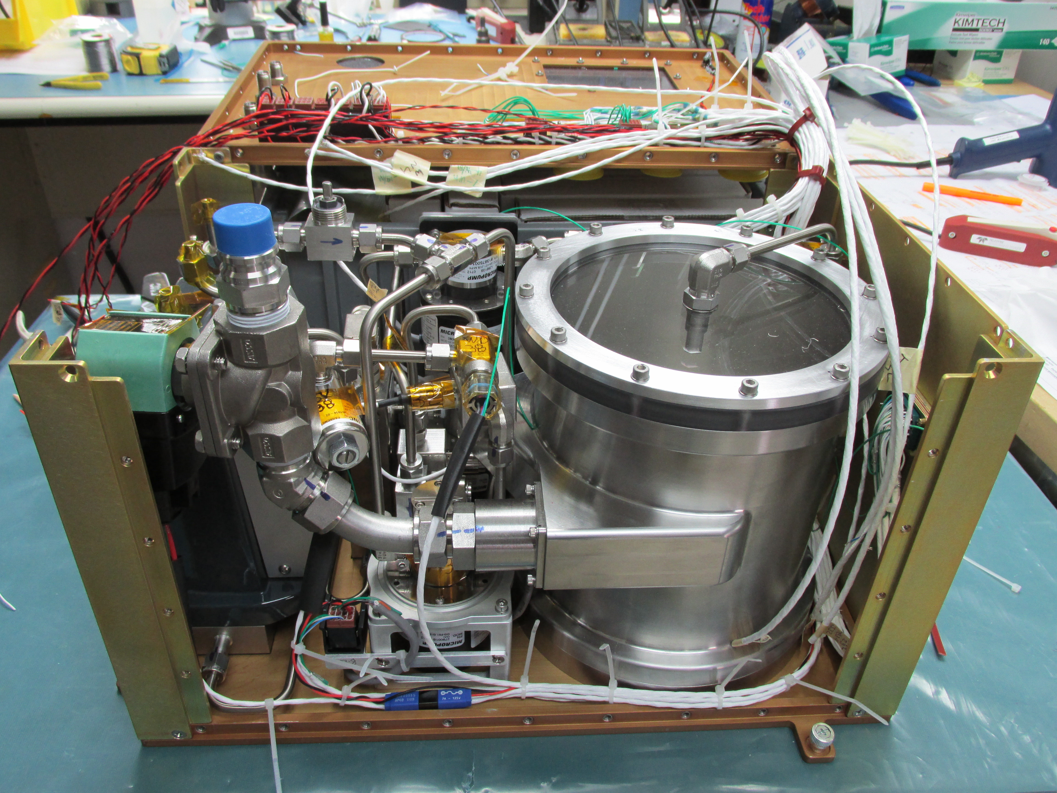
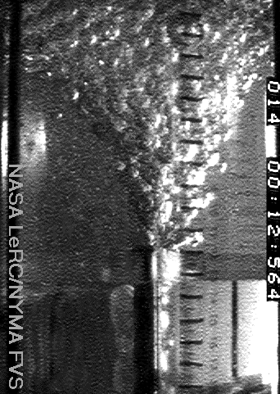
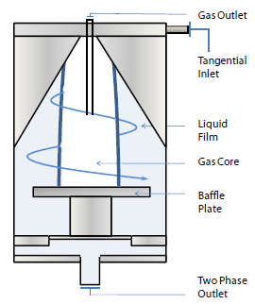
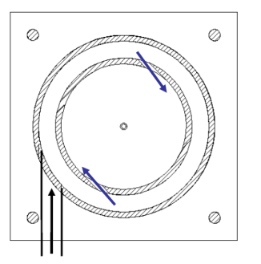
Gas-Liquid Separation Devices
Reduced Gravity Bubble Vortex
Cyclonic Concepts
Pumped Separator for PBRE
PI: Dr. Georges Chahine and Xiongjun Wu, DynaFlow, Inc.
PI: Prof. Yasuhiro Kamotani, Case Western Reserve University
Co-I: Prof. Jaikrishnan Kadambi, Case Western Reserve University
Two-Phase Flow Separator Experiment (TPFSE) – 2021
Two PI Teams will share common test hardware to study different aspects.
Experiments will determine separator performance at extreme gas/liquid mixtures and flow rates.
Determine separator stability envelope to startup, shutdown and liquid slugging conditions.
TPFSE facility can accommodate additional experimental test sections of future investigators.
Advanced separation technology is critical to high reliability, audibly quiet, and low power gas-liquid systems for use in astronaut life support, fluid degassing, and power generation.
Notes:
Gas-liquid separation in space is a significant problem. Looking for passive (non-pumped) methods to separate extreme end of each mixture (almost all gas or all liquid).

Slide 11
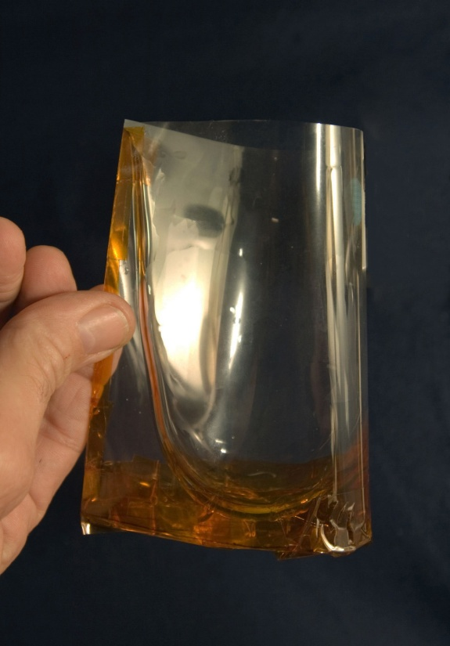
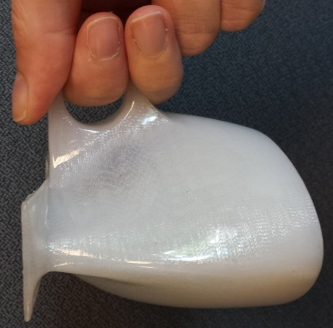
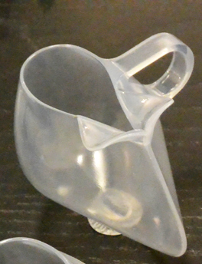
Capillary Flow and Interfacial Phenomena - Applications
When asked to name one of the biggest challenges to living in space, Astronaut Suni Williams replied that it is removing and dealing with bubbles in fluids systems.
Vented Tank Resupply Experiment (VTRE) Vane Type Propellant Management Device (PMD)
Chato, David, and Timothy Martin. “Vented Tank Resupply Experiment – Flight Test Results.” NASA Technical Memorandum 107498 (1997).
A fluid cartridge to detect infectious diseases developed through collaboration with NASA PI (CFE)
A diagram of the device for urine collection or other gas/liquid separations in low or zero gravity conditions
E.A. Thomas, M.M. Weislogel, D.M. Klaus, Design Considerations for Sustainable Spacecraft Water Management Systems, Adv. Space Res., Vol. 46, pp. 761-767, 2010
The evolution of the “coffee cup” designed for partially wetting teas and coffees in microgravity
Notes:
Capillary forces become a significant factor in low gravity. Understanding and controlling them can often work to our advantage.
Important in both life support and propellant management systems.
- A fluid cartridge to detect infectious diseases like AIDS, tuberculosis, flus and others. Northwestern University earned a grant funded by the Bill and Melinda Gates Foundation. PI Mark Weislogel collaborated with Northwestern University on his experience with NASA’s Capillary Flow Experiment.
- The evolution of the “coffee cup” designed for partially wetting teas and coffees in microgravity. The Capillary Beverage experiment was developed by IRPI, LLC through CASIS.
- A diagram of the device for urine collection or other gas/liquid separations in low or zero gravity conditions. A US patent (#US 7905946 B1) was awarded for this device in 2011.

Slide 12
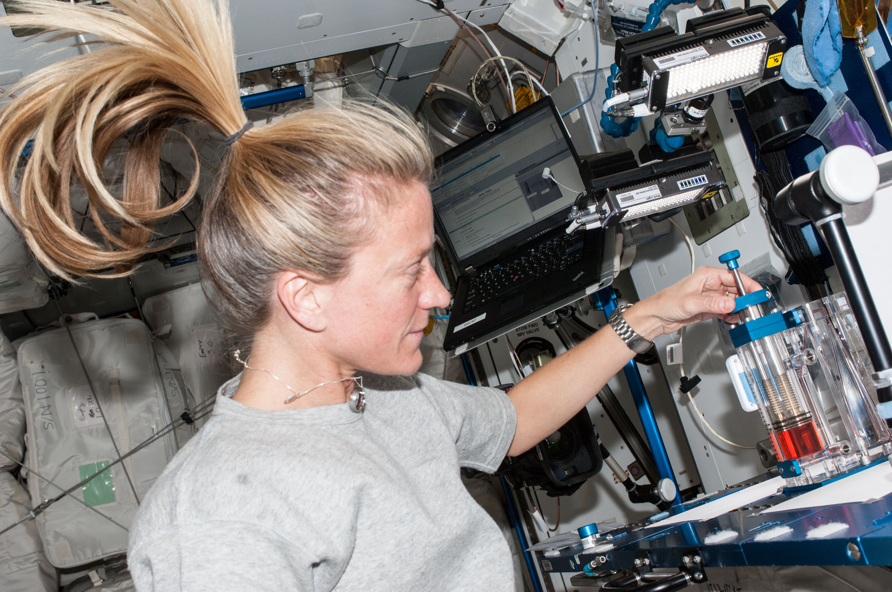
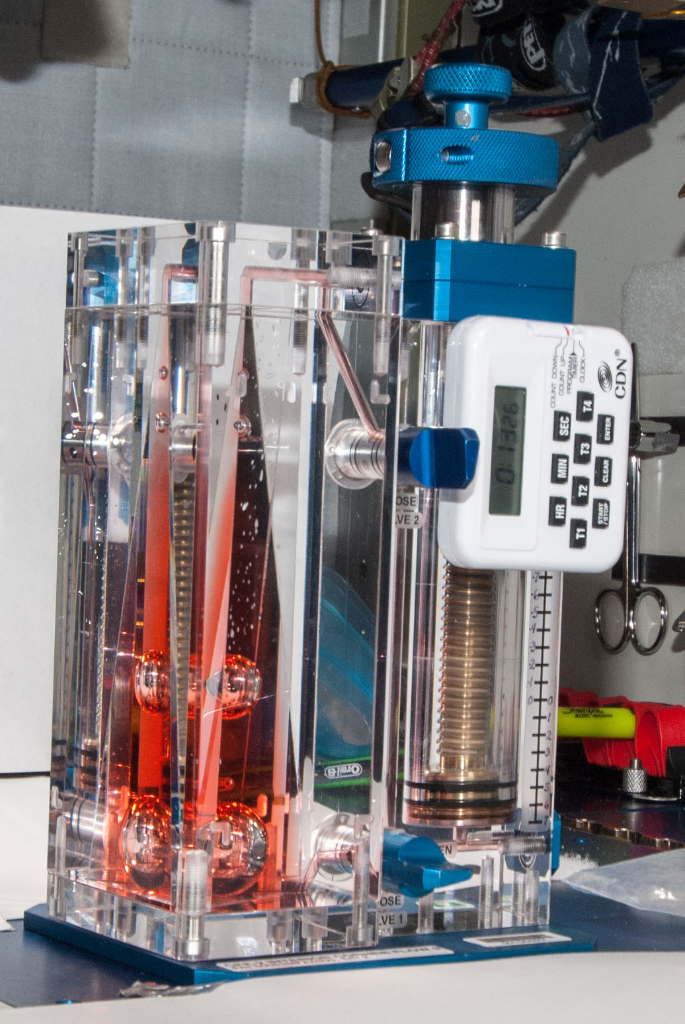
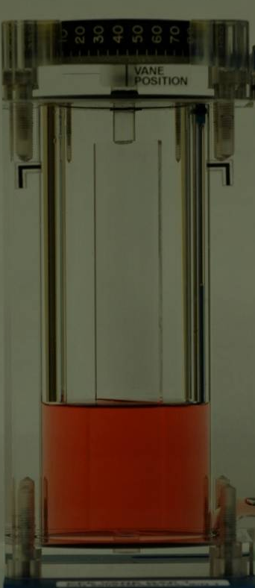
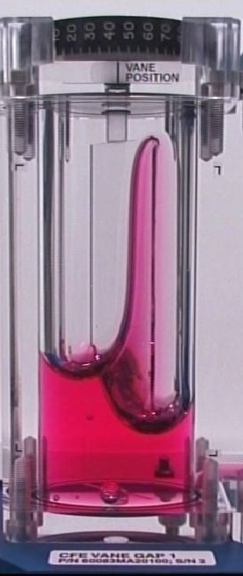
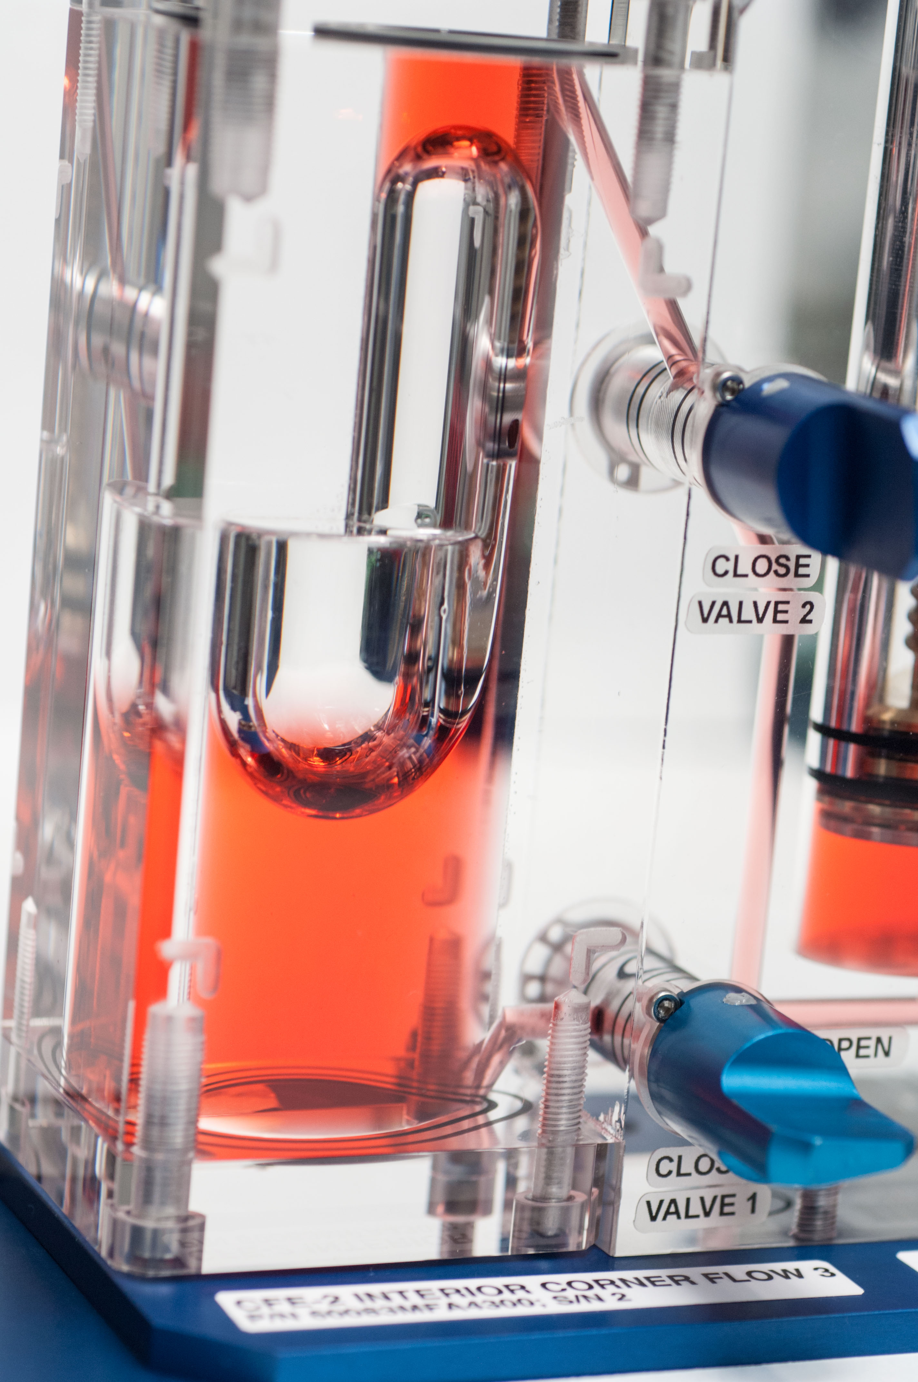
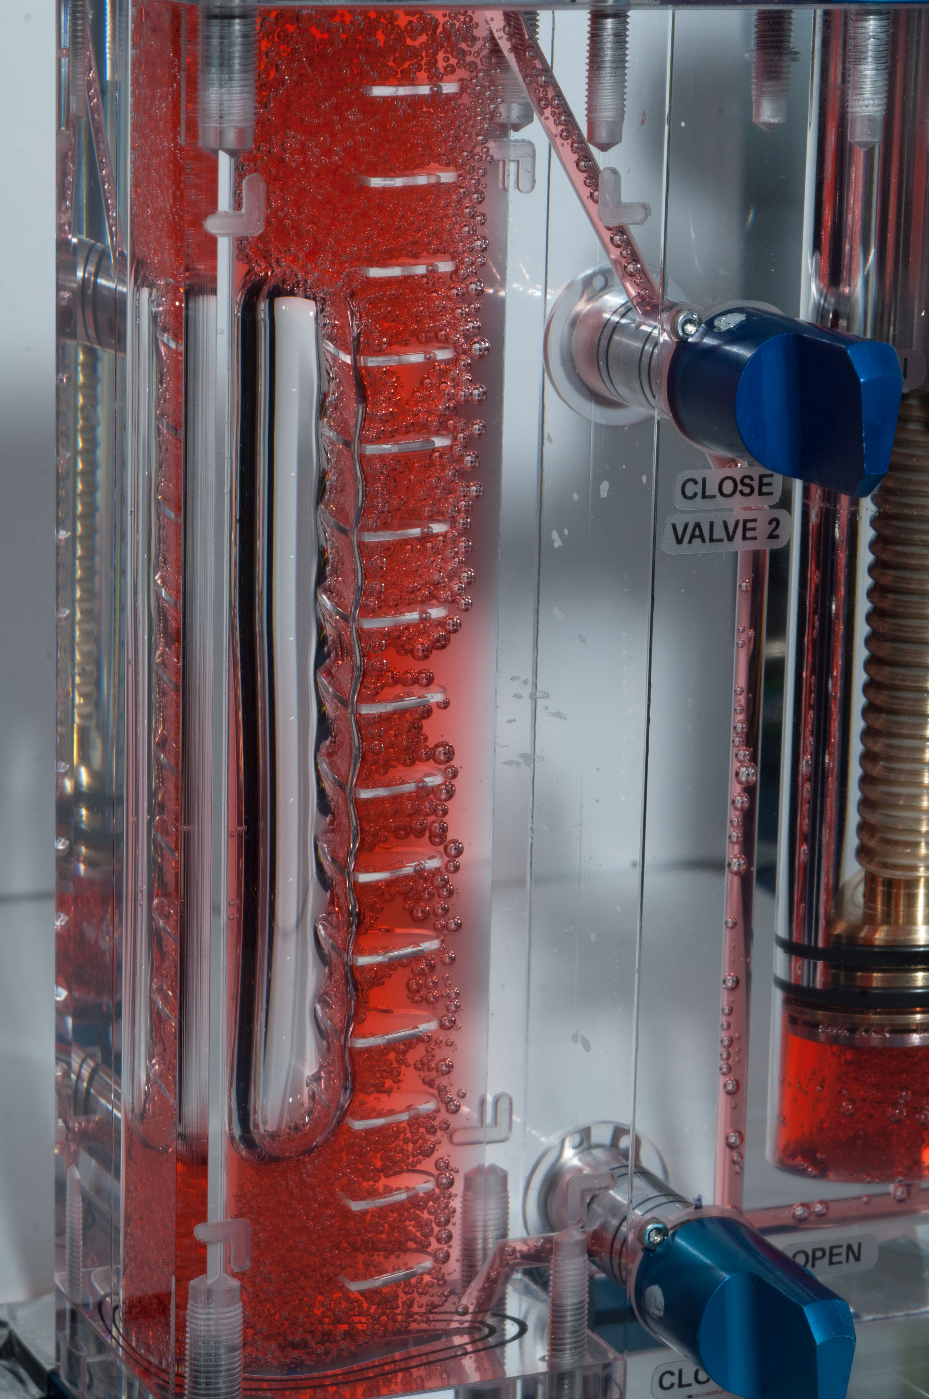
Capillary and Interfacial Phenomena
The Capillary Flow Experiment (CFE 1&2) -2004 - 2014
Series of handheld vessels with various test chamber geometries to investigate the behavior of capillary flow phenomena in wicking structures such as interior corners and small gaps created by a vane and the test chamber wall.
The working fluid is silicone oil of various viscosities, depending on the individual unit geometry.
The results of CFE have applications in propellant management for fluid storage tanks, thermal control systems, and advanced life support systems for spacecraft.
Critical wetting vane angles have been determined to within 0.5 degrees for Vane Gap 1 and 2 experiments.
A bulk shift phenomena has been characterized that has
implications for tank designs.
Astronaut Karen Nyberg adjusting the liquid volume during a CFE-2 Interior Corner Flow 9 (ICF9) experiment on ISS (June 15, 2013)
45°vane angle in earth gravity.
45°vane angle in microgravity.
Interior Corner Flow Modules (ICF3, ICF 8 and ICF9)
PI: Prof. Mark Weislogel, Portland State University
Notes:
One of the first ISS fluids experiments. Hand-held devise to study a number of geometries using silicon oil.
Widely published – including several articles in JFM, etc.

Slide 13
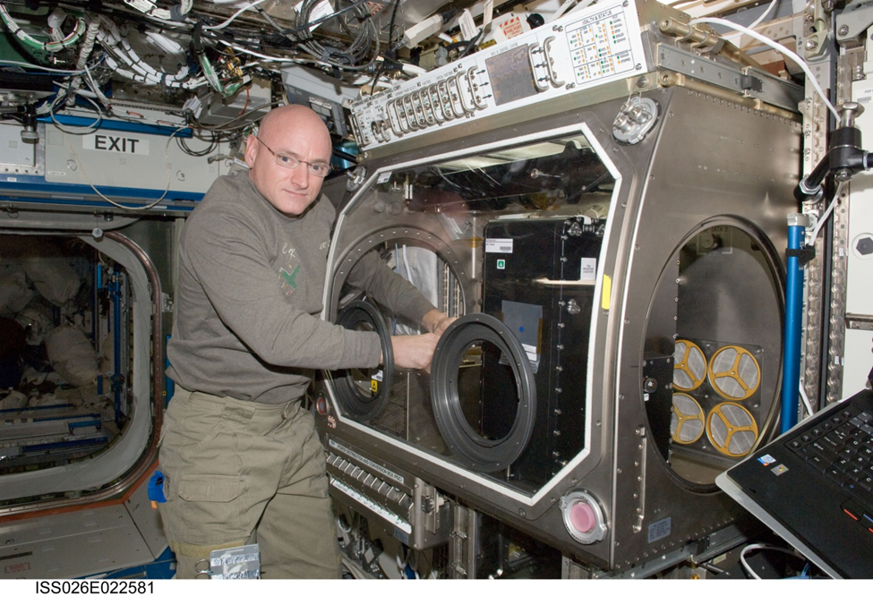
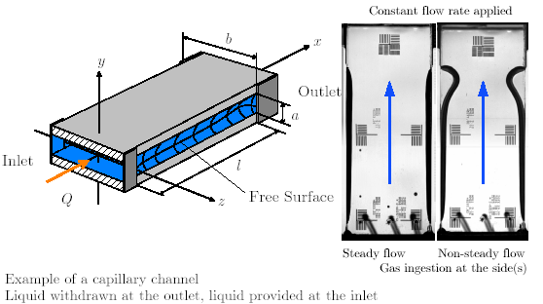
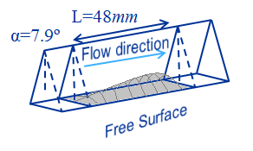
Capillary and Interfacial Phenomena
The Capillary Channel Flow (CCF) Experiment 2011–2014
Led by the German Space Agency (DLR) with a US/NASA Co-Investigator.
Study of open channel capillary flow in microgravity.
The cross section of the flow path is partly confined by free surfaces.
Experiment has led to high fidelity models that accurately predict maximum flow rates for an open capillary channel
Research is critical to on-orbit fuel transfers and in space propulsion systems that utilize capillary vanes.
Current design of spacecraft fuel tanks rely on additional reservoirs (higher mass) to prevent the ingestion of gas into the engines during firing.
Astronaut Scott Kelly installing CCF in MSG in Dec 2010.
Capillary Channel Flow Test Unit 2
(interior corner (wedge) geometry)
Gas-Liquid Phase Separation Flow Regime Map
Capillary Channel Flow Test Unit 1
(flat plate and groove geometries)
PI: Prof. Michael Dreyer, ZARM
US Co-I: Prof. Mark Weislogel, Portland State University
13
Notes:
German led
Important when starting up engines (rockets) in space prior to settling fluid in tank due to thrust.
Propulsion engineers want near full thrust as soon as possible so we over design liquid acquisition systems.

Slide 14
Boiling and Condensation - Applications
2011 Decadal: “Research literature, unfortunately, contains only very limited data on pool boiling in reduced gravity. Thus, available correlations and models are unable to provide reliable data on nucleate boiling and critical heat flux in reduced gravity.”
Notes:
Life support and thermal control systems.

Slide 15
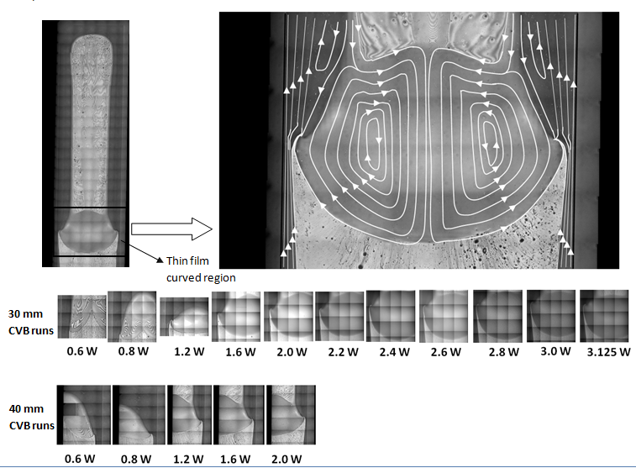
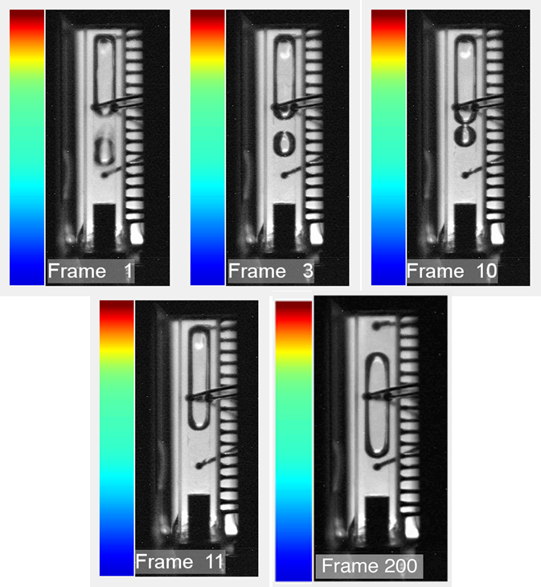
Boiling and Condensation
Constrained Vapor Bubble (CVB) Experiment – 2009 & 2013
Prototype for a wickless heat pipe in microgravity – based
on corner flows.
Used pure Pentane as operating fluid for first set of experiments.
Provided fundamental transport data including the overall stability,
flow characteristics, average heat transfer coefficient in the evaporator, and heat conductance as a function of heat flow rate and vapor volume.
Interferometry technique obtained direct measurements of fluid curvature and thickness.
Visualized film stability and shape of dry out regions with a microscope in detail never obtained before in microgravity.
CVB-2 (2013) extended data to a binary mixture rather than a pure fluid (Pentane – Isohexane).
Discovered a new limit for heat pipe operation: Marangoni or Flooding limit.
First performance limitation is flooding, not dryout of the heater end.
Wickless designs can pump more than enough liquid to the heater end.
Flooding limitation can be broken by the addition of a second, liquid, component. This may be the origin of reported enhancements using mixtures.
Unexpected phenomena were observed and enhanced in microgravity including meniscus oscillations, autophobic droplet formation, and controlled single bubble nucleation phenomena ( a hybrid pool/flow boiling experiment not accessible in 1-g environments).
Marangoni limit and flooding of heater end with flow streamlines.
Unexpected Explosive Nucleation in 0-g.
PI: Prof. Joel L. Plawsky, Rensselaer Polytechnic Institute
Co-I: Prof. Peter C. Wayner, Jr., Rensselaer Polytechnic Institute
Notes:
Fundamental study of wickless heat pipe

Slide 16
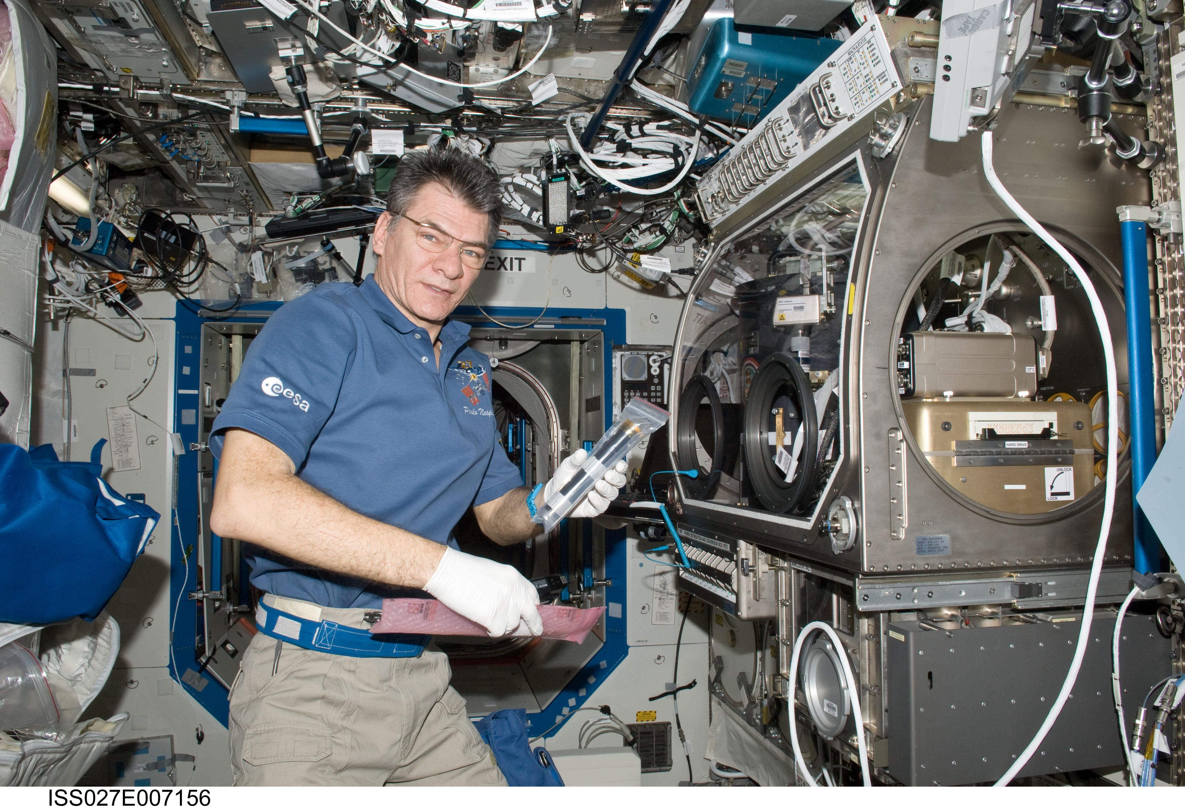
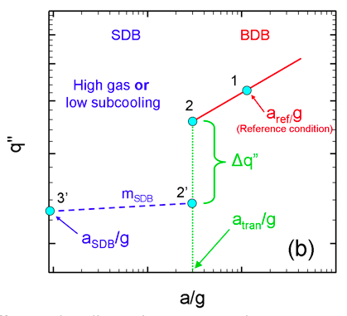
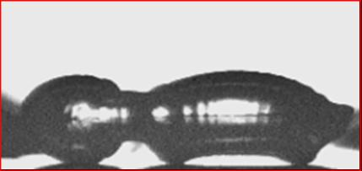
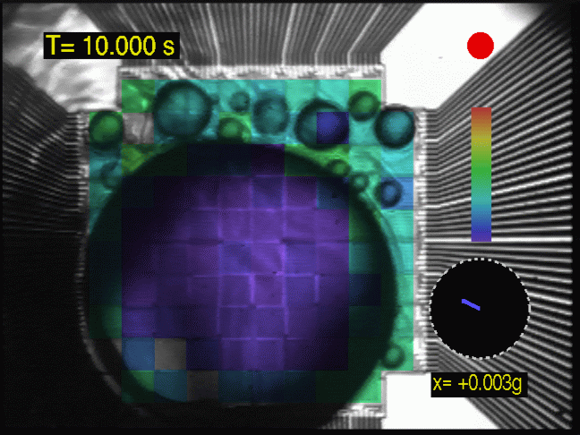
Boiling and Condensation
PI: Prof. Jungho Kim, University of Maryland
PI: Prof. Vijay K. Dhir, UCLA
Boiling eXperiment Facility (BXF) – 2011
BXF included two separate pool boiling investigations:
Microheater Array Boiling Experiment (MABE)
Nucleate Pool Boiling Experiment (NPBX).
Advanced understanding of local boiling heat transfer mechanisms & critical heat flux in microgravity for nucleate and transition pool boiling.
Detailed measurements of bubble growth, detachment and subsequent motion of single and merged (larger) bubbles.
Developed a criteria for Boiling Transition
Buoyancy Dominated Regime (BDB)
Heat transfer by bubble growth and departure
Heat flux increases with gravity
Surface Tension Dominated Regime (SDB)
Dominated by the presence of a non-departing primary bubble
Effect of residual gravity is very small
Transition Criteria based on Capillary Length
Paulo Nespoli installing BXF in MSG.
50
W/cm²
0
Transition of boiling Heat Flux as a function of acceleration.
.
(Left) Coalescence of vapor bubbles on NPBX wafer.
(Right) Subcooled nucleate boiling in μg. The MABE microheater array is colorized with actual heat flux data.
16
Notes:
Two pool boiling experiments – the extreme condition in space.

Slide 17
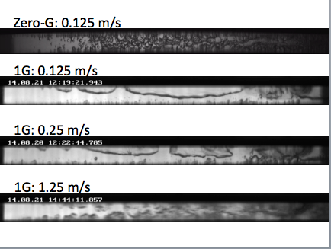
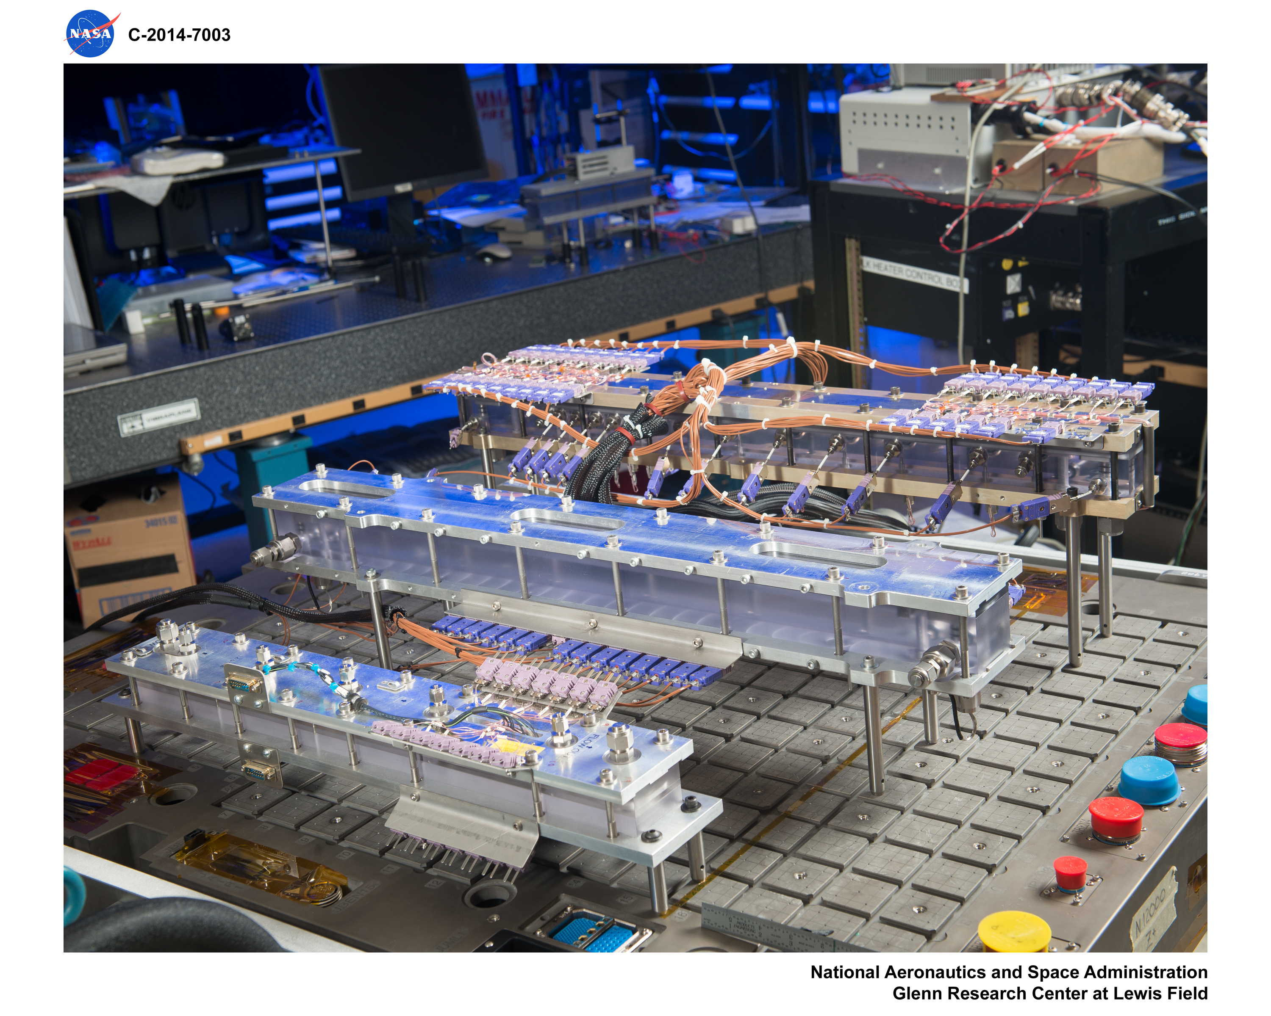
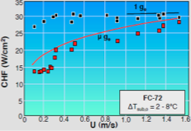
Boiling and Condensation
Flow Boiling and Condensation Experiment (FBCE) – 2019
Will develop mechanistic models for microgravity flow boiling Critical Heat Flux (CHF) and dimensionless criteria to predict the minimum flow velocities required to ensure gravity-independent CHF along with boiling heat transfer coefficients and pressure data correlations.
Will develop mechanistic model for microgravity annular condensation and dimensionless criteria to predict minimum flow velocity required to ensure gravity-independent annular condensation; also develop correlations for other condensation regimes in microgravity.
Recently completed an axisymmetric 2-D computational model developed to predict variations of void fraction, condensation heat transfer coefficient, wall temperature and temperature profile across the liquid film.
PI: Prof. Issam Mudawar, Purdue University
Co-I: Dr. Mojib Hasan, NASA GRC
Critical Heat Flux (CHF) data and model predictions for microgravity and Earth gravity for flow boiling.
FBCE Test Module
17
Notes:
Next step is to consider flow boiling
For a given flow rate, how much heat can be transferred prior to CHF or condensation heat transfer coefficients.

Slide 18
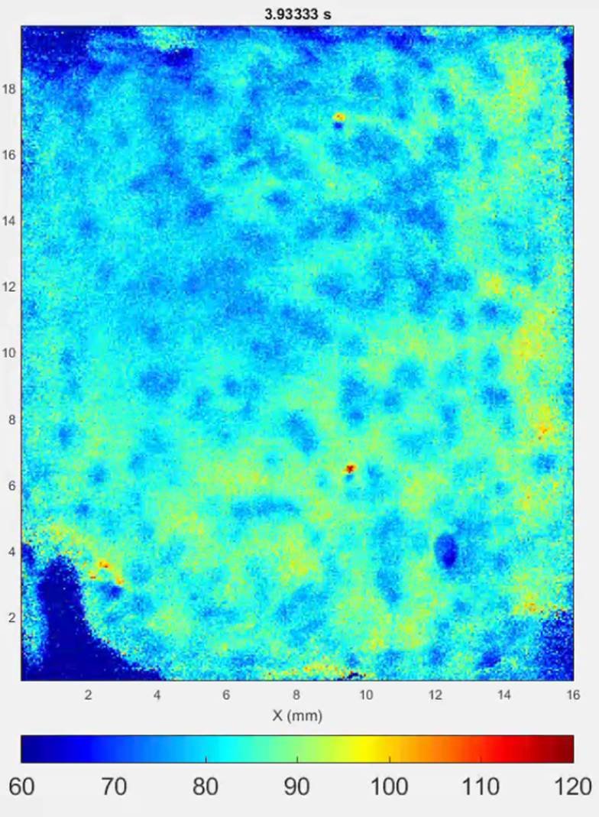
Boiling and Condensation
PI: Prof. Jungho Kim, University of Maryland
ESA PI: Catherine Colin, Institut de Mécanique des Fluides de Toulouse
Multiphase Flow and Heat Transfer Experiment (MFHT) - 2019
Will develop models that incorporate two-phase flow regimes and fluid conditions to predict local heat transfer coefficients from subcooled nucleate boiling through critical heat flux (CHF) and dryout.
Will obtain local measurements of the wall heat transfer coefficient with high temporal and spatial resolution using an infrared video (IR) camera.
ESA to provide carrier and facility: (Fluid Science Laboratory (FSL) Thermal Platform
ESA will build and develop flight hardware/insert.
NASA will design, build and test prototype insert.
Snapshot of pool boiling data using quantum dots to measure temperature
18
Notes:
ESA led with US PI.
Will focus on high resolution local heat flux (both in time and space) using novel IR camera.

Slide 19
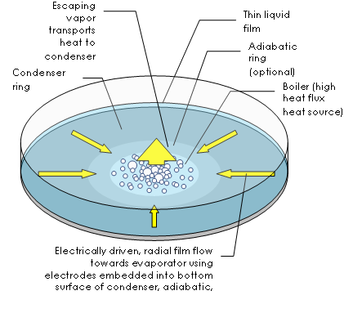
Boiling and Condensation
Electro-Hydrodynamic Device (EHD) – 2021
Uses a dielectric fluid to electrically drive liquid to the heated area – forcing the bubbles away from the nucleation sites.
Will develop fundamental understanding and physical models to characterize the effects of gravity on the interaction of electric and flow fields in the presence of phase change.
Will characterize electrowetting effect on boiling and CHF in the absence of gravity.
Micro-scale devices have extremely high heat fluxes due to the small heat transfer surface area.
Provides a robust, non-mechanical, lightweight, low-noise and low-vibration device.
PI: Prof. Jamal Seyed-Yagoobi, Worcester Polytechnic Institute
Co-I: Jeffrey Didion, NASA GSFC
19
Notes:
Using a dielectric fluid to cool small areas of high heat flux (such as those generated by certain electronics).

Slide 20
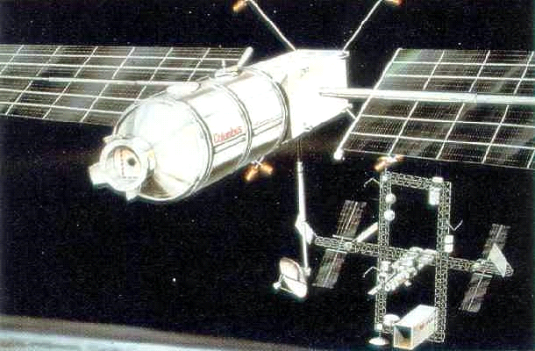
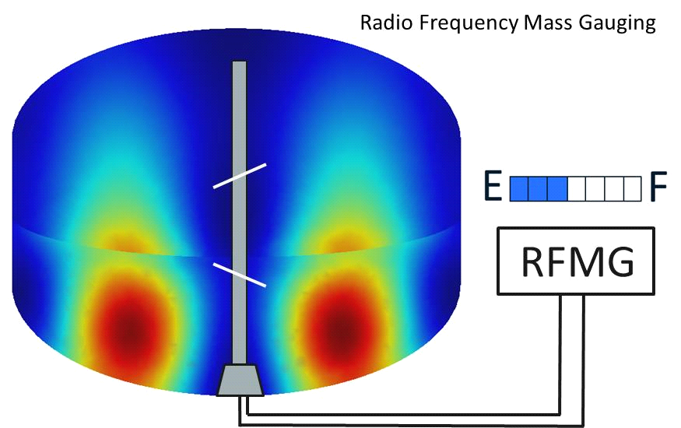

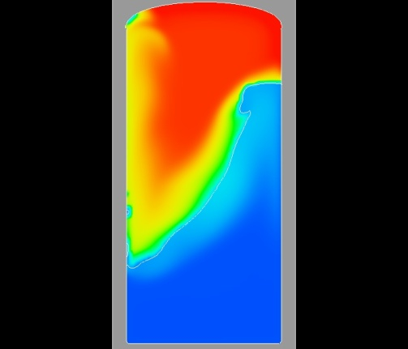




Cryogenic Storage & Handling - Applications
CPST
Cryogenic Propellant Storage & Transfer
ESA Columbus Free Flyer
Radio-frequency Mass Gauging
“The data obtained from these highly controlled and instrumented experiments in the microgravity environment will be critical for validating models that will be used to design integrated low- and zero-boil-off cryogenic fluid storage and utilization concepts for a wide range of missions.”
Jeffrey Sheehy,
Senior Technical Officer, STMD
Model Validation: Tank Spray Droplet Pressure Control
Capturing Liquid Slosh Dynamics

Slide 21




Cryogenic Storage & Handling
Zero Boil-Off Tank Experiment (ZBOT) - 2016
Will study storage tank pressurization & pressure reduction through fluid mixing in microgravity (ZBOT-1).
Add the effects of non-condensable gasses (ZBOT-2). The presence of non-condensables produces barriers to the transport of vapor to and from the interface creating gradients of the gaseous concentrations along the interface may give rise to Marangoni convection. This changes the pressurization and pressure reduction rates.
ZBOT-3 will characterize tank thermal destratification and pressure reduction through active cooling schemes for: (i) sub-cooled jet mixing (ii) droplet spray-bar mixing; and (iii) broad area cooling with intermittent mixing.
ZBOT provides an instrumented test section with controllable BCs; velocimetry; and flow visualization.
ZBOT EU
Effect of Noncondensable on Flow and Temperature Fields during Jet cooling Pressure Control
Pure Vapor - Cool Jet envelopes the Ullage
NonCondensable Pressurant
Broad Area Cooling: Radiative Loss to Cooled Isolation-Jacket
Marangoni Flow Due to
Noncondensable Impedes Penetration of Cool jet around the Ullage
LAD
Cold Finger
PI: Dr. Mohammad Kassemi, NCSER
Co-I: Dr. David Chato, NASA, GRC
Mixing/Cooling: Spray-Bar
Mixing/Cooling: Sub-Cooled Jet
21
Notes:
Scheduled to fly next year
Uses a surrogate fluid – perfluoro-N-pentane (boils just above RT – 29 C )

Slide 22


http://psi.nasa.gov

Slide 23
BACKUP SLIDES
Notes:
Fluid physics handbook just published (thru JSC).
Telecon with Jitendra, Molly Anderson, Fran, on Friday?
Working on updating a design guide for two-phase flows in microgravity.

Slide 24



Slide 25



Slide 26



Priorities for Adiabatic Two-Phase Flows
Priority # 1:
Utilize ISS to develop fundamental tools to predict phase location and flow dynamics in two-phase systems to discern the effects of gravity.
.
Low Gravity Bubbly Flow Through Sudden Expansion that fills expanded area
Low Gravity Bubbly Flow Through Sudden Expansion resulting in two-phase bubbly jet
Priority # 2:
Predict and understand two-phase closed-loop system behavior with a focus on transients, oscillations and the evolution of phase distribution to ensure safe and reliable operations.
Rupture of Liquid Film in Slug Flow due to Instability
Priority # 3:
Predict and understand the mechanisms for bubble and droplet coalescence, interactions and dynamics.
Bubble Flow Coalescence in Cyclonic Separator

Slide 27



Priorities for Capillary Flow and Interfacial Phen.
Priority # 1:
To create the ability for many users to simply and rapidly perform numerous capillary flow studies, from simple to complex, on ISS.
Priority # 2:
Determine moving contact line boundary conditions (perfect, partial or varying wetting, non-wetting) due to contaminants, surfactants, surface finish, and particulates and, investigate advancing/receding contact lines (e.g. hysteresis at the contact line) in a variety of capillary flow sensitive geometries.
CFE Contact Line for partially wetting conditions. Pinning edge (right) vs smooth cylinder (left).
Priority # 3:
Determine global equilibrium criteria in non-symmetric and symmetric geometries for liquid management. There are often many possibilities for static liquid positioning. Additional theoretical work is critical in determining when to expect problems in various geometries of interest.
Two different global equilibrium points for the same test chamber geometry.

Slide 28





Priorities Boiling and Condensation
Priority # 1:
Develop approaches to enhance boiling heat transfer, delay CHF, predict the onset of boiling, and develop and validate predictive models. Significantly advance our understanding of the physics of flow boiling CHF and instabilities in microgravity.
Rankine Cycle is best option for high power systems in space (> 100 kW).
Critical Heat Flux (CHF) data and model predictions for microgravity and Earth gravity for flow boiling.
Priority # 2:
Develop capabilities to predict flow condensation heat transfer performance in microgravity. Factors to be addressed include: non-condensable gas, wave effects, inlet superheat / subcooled outlet effects, enhancement techniques, tapered channels, flow passage effects, capillary enhancement techniques, surface modification, drop-wise condensation.
Priority # 3:
Develop understanding of instabilities (multichannel flow reversals, flooding, etc.), transients (start-up, loss of coolant, load variation), evaporator / condenser phase separator, NCG separation - removal - isolation, and loop sensing and feedback control strategies.
Reconfigurable Thermal Control System

Slide 29




Priorities Cryogenic Storage & Handling
Priority # 1:
Understand the impact of noncondensables gases on tank pressurization and pressure control in microgravity.
Establish a microgravity science & engineering foundation for comparison and optimization of axial-jet and spray-droplet tank pressure control designs.
Pure Vapor
Non-Condensable
Priority # 2:
Understand the impact of microgravity boiling, interfacial turbulence and curvature, and impulse accelerations on tank pressurization.
Study tank chill down and tank pressurization using submerged and non-submerged injectors – logical extension to ZBOT series.
Simulation of Tank Chilldown in Space
Priority # 3:
Understand different aspects of storage tank phase management and phase control in microgravity using different devices:
Capillary fluid dynamics – extends CCF work
Hydrophobic materials
Dielectrophoretic forces
Radio-Frequency mass gauging
Large Scale Capillary Devices
Dielectropheretic Phase Management

